Slide 2
Droop Control Method
Although many DCM controls have been proposed, all control architectures strive to ensure equal load sharing while maintaining low voltage regulation of the system.
Control architectures generally belong within one of three design schemes:
(1) hierarchical control;
(2) control without communication;
(3) distributed control

Slide 3
As the name implies, hierarchical control is a “top-down” control scheme relying on a common centralized control system

Slide 4
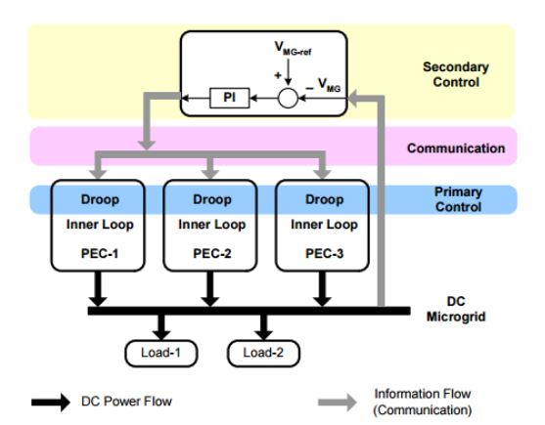

Slide 5
Hierarchical schemes are composed of three main control systems: primary control, secondary control and tertiary control.
Primary control is enacted within power electronic control (PEC) systems contained within each unit of the infrastructure.
Primary control of the PEC modifies DCM network power by comparing the microgrid voltage with a reference value.

Slide 6
The error between these two values is processed through a Proportion-Integral (PI) controller and the output of the PI is communicated to DGs to regulate power output (droop).
Also contained within each unit’s PEC is an inner loop control which serves to regulate the voltage and current delivered to each load

Slide 7
Secondary control is centralized among the DCM and is designed to organize the output of the various primary controllers throughout the network. Secondary control receives input from the energy management system, or tertiary control.

Slide 8
The energy management system acts as the gatekeeper between the utility grid and the DCM, communicating with Distributed System Operators (DSO) or Transmission System Operators (TSO) to decide the schedule of power exchange between the DCM and utility grid.

Slide 9
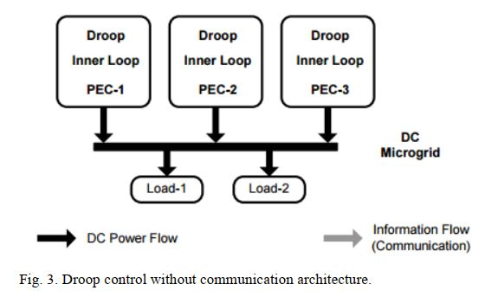

Slide 10
Unfortunately, droop control systems without communication suffer from error in power sharing for two main reasons:
(1) unequal nominal voltages;
(2) load distribution difficulties.

Slide 11
Controllers are able to communicate with one another through a common bus in order to appropriately regulate individual droops. To accomplish this, individual source currents are measured at the source and converted to a voltage signal

Slide 12
Control architectures of multiple DCMs to create a larger networked infrastructure is yet another area of active research into microgrid technologies.
These larger networks, or multiagent systems (MAS), are capable of managing power at a higher level beyond that of the individual DCM, creating an additional level of regulation

